Slide 1
PARALLEL BUCKET SORT
By:
Prasanna Lad (21)
Devesh Panchal (31)
Rutuja Parab (32)
Guided by:
Sneha Mhatre Ma’am

Slide 2
ABSTRACT
Bucket sorting algorithm achieves O(n) running time complexity in average. It is very fast compared to any comparison-based sorting algorithms that usually have a lower bound of Ω(n log n). Given an unsorted array of n positive integers, bucket sorting algorithm works by distributing the elements into m ordered buckets each contains zero or more elements. Each bucket is then sorted using either a different sorting algorithm or recursively using bucket sorting algorithm. At the end, elements are gathered from each bucket in order, so the input array is sorted. With the O(n) complexity, the bucket sorting algorithm can execute and finish sorting very quickly in sequential processing. However, this execution time can even be improved by parallelizing the sorting of each bucket. Furthermore, it is a scalable algorithm as its performance can be linearly improved with the increase of core number of multicore processors.

Slide 3
INTRODUCTION
Sorting algorithm can be classified into two categories, comparison-based sorting and non comparison-based sorting.
Bucket sort is an example of a sorting algorithm.
Bucket sort works in two phases.

Slide 4
ALGORITHM
Algorithm 2 Parallel Bucket Sorting Algorithm.
N: number of unsorted elements
M: number of buckets, k: number of threads
1: Initialize an array of empty “buckets”.
2: Partition the original array into k sets, each has N/k
elements.
3: In parallel, each thread performs the following:
Go over N/k elements in the original array and put
them in the bucket based on their values.
4: Partition buckets into k sets, each has M/k buckets.
5: In parallel, each thread performs the following:
Sort M/k non-empty buckets.
6: Visit the array of buckets in order and put the sorted
elements back to the original array.

Slide 5
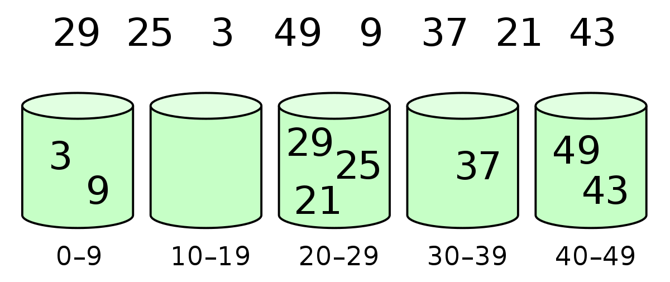
EXAMPLE

Slide 6
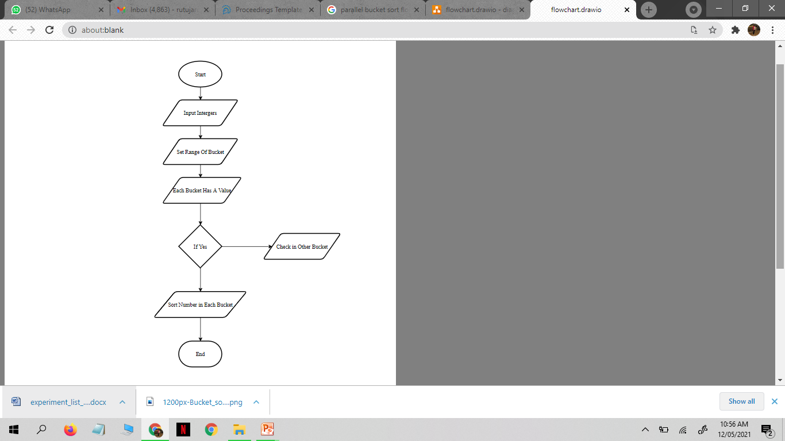
FLOWCHART

Slide 7
OUTPUT

Slide 8
CONCLUSION
Utilizing the evolving multicore processor architecture, this paper shows how the sequential bucket sorting algorithm can be converted to a parallel bucket sorting algorithm and be implemented in C and executed using OpenMP API. This is when the communication and synchronization overheads among the parallel threads are overcome by the speedup. Otherwise, sequential computation by single thread is preferred when the test datasets are small. Since only a small portion of the algorithm is parallelized, the speedup gain is not significant, only about 1.05.

Slide 9
REFERENCES
Chapman, Barbara, Gabriele Jost, and Ruud Van Der Pas. Using OpenMP: portable shared memory parallel programming. Vol. 10. MIT press, 2008.
Kim, Kil Jae, Seong Jin Cho, and Jae-Wook Jeon. "Parallel quick sort algorithms analysis using OpenMP 3.0 in embedded system." Control, Automation and Systems (ICCAS), 2011 11th International Conference on. IEEE, 2011.
http://openmp.org/wp/
https://www.sjsu.edu/people/robert.chun/courses/cs159/s3/N.pdf

